Slide 1

ICCCBE 2024 / Montreal
The 20th conference of the International Society for Computing in Civil and Building Engineering
August 25 to 28, 2024

Slide 2

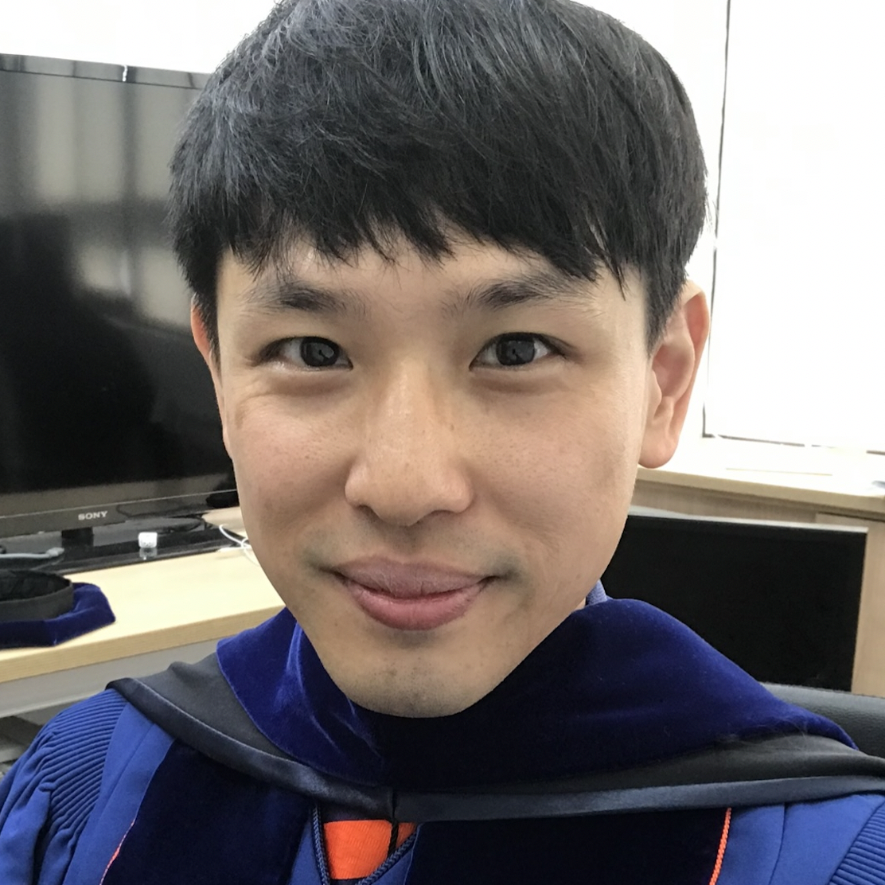

ICCCBE 2026 / Taipei
The 21th conference of the International Society for Computing in Civil and Building Engineering
March 25 to 27, 2026
Professor
Albert Chen
Civil Engineering
National Taiwan University
ICCCBE 2026 / Taipei

Slide 3
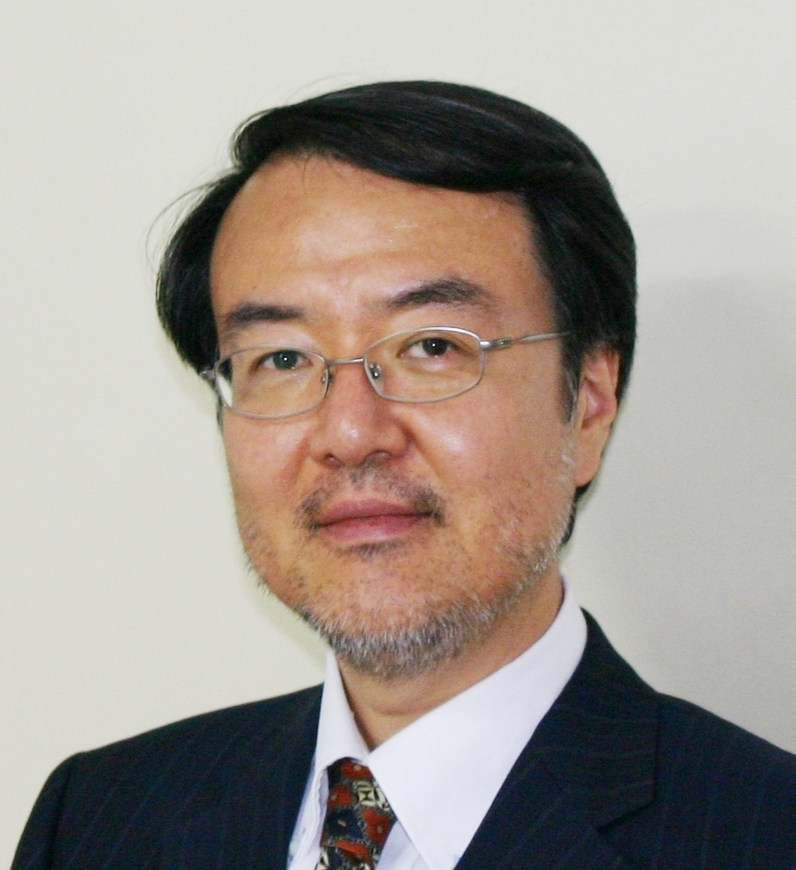

ICCBEI 2025 / Hong Kong
The 6th International Conference on Civil and Building Engineering Informatics
January 8 to 11, 2025
Professor
Nobuyoshi Yabuki
Division of Sustainable Energy and Environmental Engineering, Graduate School of Engineering

Slide 4


ACCBEI 2025 / Cape Town
The 1rst African Conference on Computing in Civil and Building Engineering
November 20 to 22, 2025
Professor
Sebastian Skatulla
Director: Computational Continuum Mechanics Research Group
and Social Responsiveness
Department of Civil Engineering

Slide 5



ICCCBE 2024 / Montreal
Closing Session
Announcements
Student Competition

Slide 6
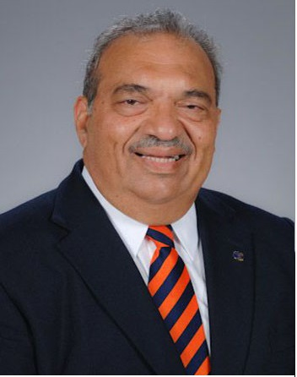
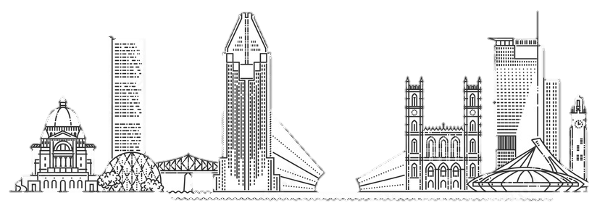
CLOSING SPEECH
Distinguished Professor
Raymond Issa
President of the society
ISCCBE
ICCCBE 2024 / Montreal

Slide 7
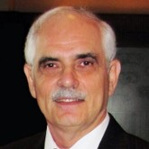
CLOSING SPEECH
Professor
Edmond Miresco
Conference Chair
ICCCBE 2024 / Montreal

Slide 8

OFFICIAL CLOSING
ICCCBE 2024 / Montreal
Edmond Miresco
Conference Chair
Raymond Issa
President of the society

Slide 9

See you in
ICCCBE 2026 / TAIPEI

