Slide 1

ICCCBE 2024 / Montreal
The 20th conference of the International Society for Computing in Civil and Building Engineering
August 25 to 28, 2024

Slide 2




ICCCBE 2024 / Montreal
ANNOUCEMENTS

Slide 3
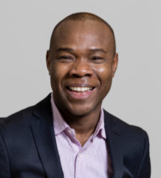
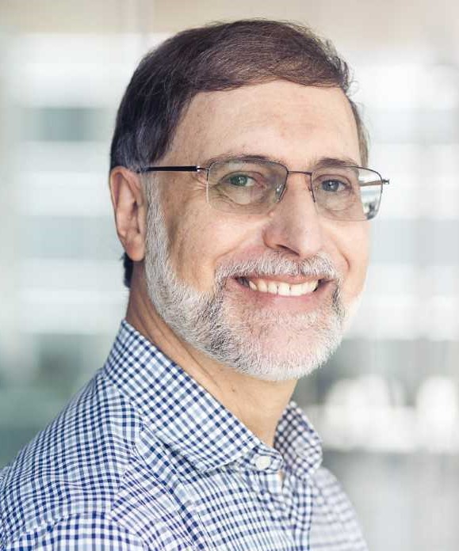
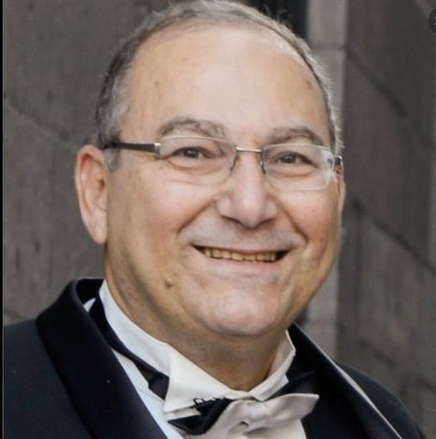
ICCCBE 2024 / Montreal
KEYNOTE SPEAKER
“Advancing 4D Simulation for Construction Projects: Evaluating Industry Needs and Future Outlook” by
Prof. Conrad Boton Prof. Silvio Melhado Prof. Adel Francis
Construction Engineering Department, École de technologie supérieure (ÉTS), Quebec University

Slide 4
ICCCBE 2024 / Montreal

