Slide 1

ICCCBE 2024 / Montreal
The 20th conference of the International Society for Computing in Civil and Building Engineering
August 25 to 28, 2024

Slide 2




ICCCBE 2024 / Montreal
ANNOUCEMENTS

Slide 3
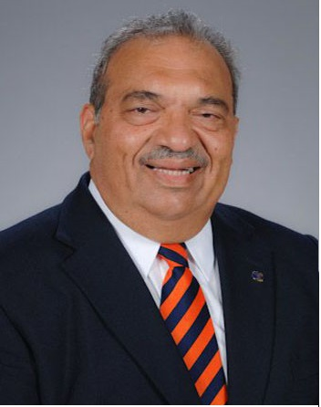
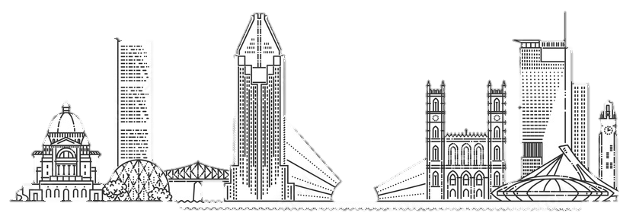
KEYNOTE SPEAKER
“From Digital Twins to Physical Twins: A Paradigm Shift” by
Distinguished Professor
Raymond Issa
President of the society
ISCCBE
ICCCBE 2024 / Montreal

Slide 4
ICCCBE 2024 / Montreal

